Slide 1
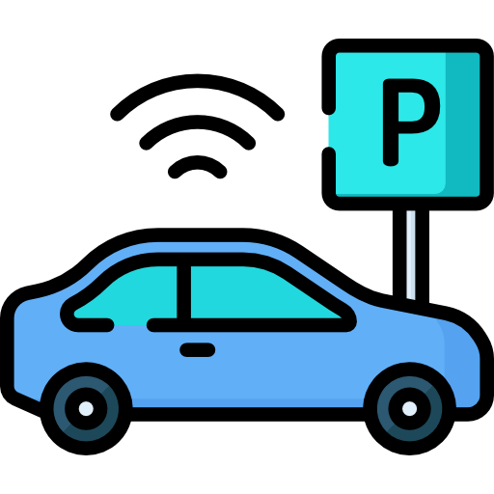
Computer Vision - CS385
Commercial Parking System and Number Plate Detection
Ganji Sree Harsha Praneeth

Slide 2
Why Commercial Parking System?
Use of Aruco Tags
Number plate detection
Efficient Space Utilisation
Revenue Optimisation using dynamic pricing
Real time occupancy information
Parking System
Each tag is mapped to a slot
Useful in extracting features like in/out time, live occupancy status of a slot
Computer Vision to detect slots, export info like in/out time etc
ML model for Dynamic Pricing using the data
Number Plate Detection using easyocr and yolo
Maintain a record of the vehicles parked
Map membership status to vehicle number

Slide 3
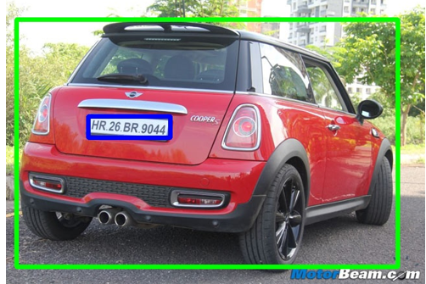
Number Plate Detection
Vehicle Detection using YOLO
YOLO is a real-time object detection algorithm that divides an image into a grid and predicts bounding boxes and class probabilities for objects within each grid cell.
Two instances of YOLO model a) detect vehicle based on Roboflow dataset b) detect license plates using a custom-trained YOLO model
License Plate Detection using EasyOCR
EasyOCR is an OCR library that provides an interface for optical character recognition.
The detected license plates are cropped from the original image, and then processed by the EasyOCR reader to extract the alphanumeric characters.

Slide 4
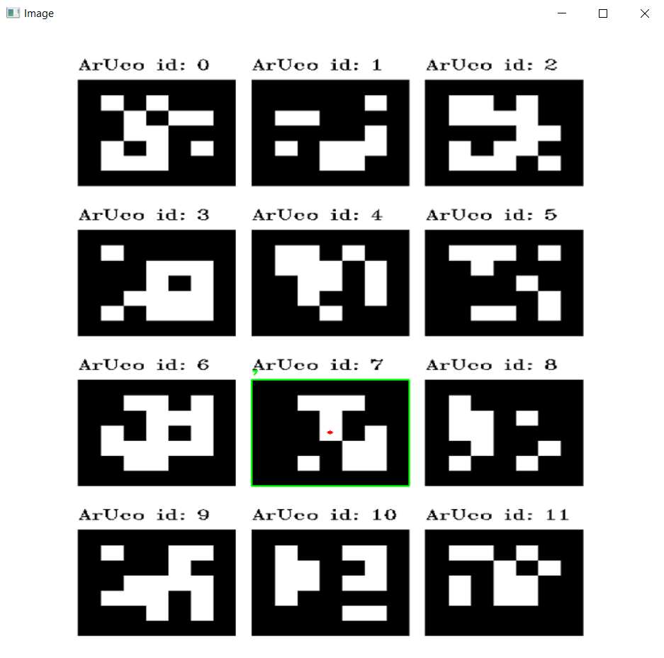
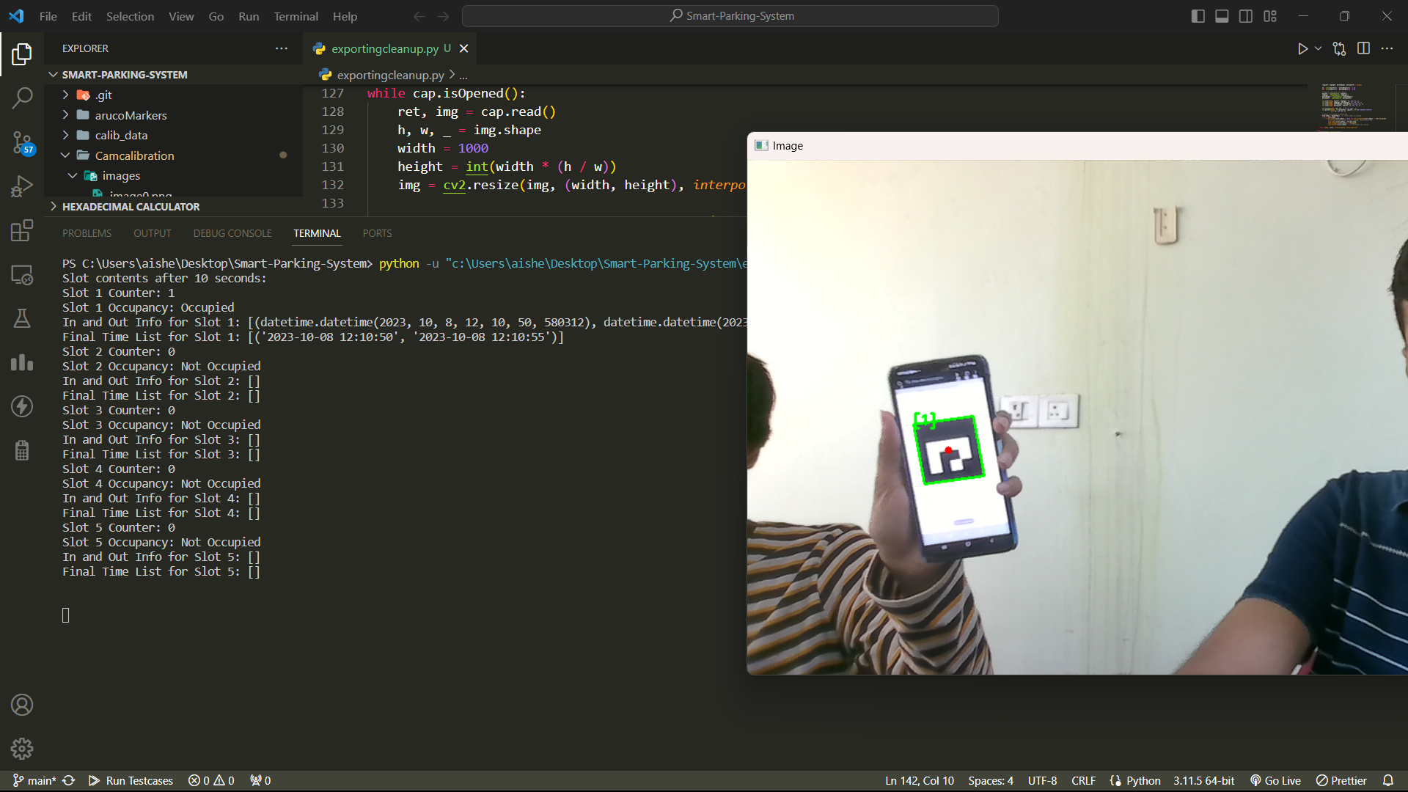
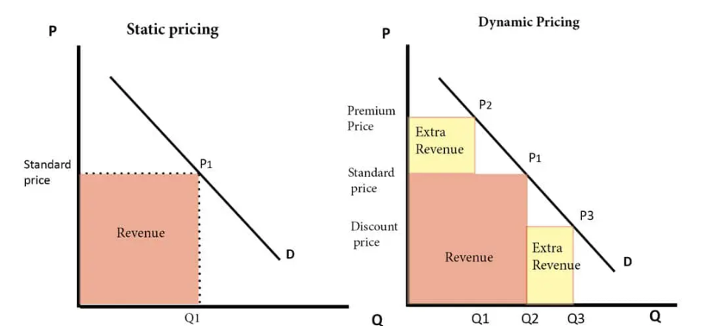
Aruco Tag Detection in Real Time
Dynamic Pricing
ArUco (Augmented Reality University of Cordoba) tags are a type of 2D barcode-like markers with a unique identifier encoded in its pattern.
We detect these aruco tags in real time and update the status of a slot as Occupied or Unoccupied.
As soon as a slot is occupied, a timer starts corresponding to the respective slot.
We keep track of the occupied time and push it into a list after a fixed amount of time.
We further clean this list to only store the entry and exit times, in a new list, which we export to train the dynamic pricing model.
This data is exported, which will be useful in Dynamic Pricing
A Linear regression model is used to determine the price using the following features - DayOfWeek, TimeOfDay, IsSpecialDay, HistoricalReservations(How many times the slot has been booked), Occupancy Status of a slot, TotalAvailableSpots, PercentageAvailableSpots (Available from real time data), CustomerType, MembershipStatus (linked to number plate)

Slide 5
Regression Model
DynamicPrice= β0
+ β1⋅DayOfWeek
+ β2⋅TimeOfDay
+ β3⋅IsSpecialDay
+ β4⋅HistoricalReservations
+ β5⋅Occupancy
+ β6⋅TotalAvailableSpots
+ β7⋅PercentageAvailableSpots
+ β8⋅CustomerType
+ β9⋅MembershipStatus +ϵ
Takes a value from 1 to 7
Inputs the time when slots gets occupied
Boolean variable
Previous reservations of the specific parking slot
Captures number of occupied slots in real time
Captures number of available slots in real-time
Categorises the customer

Slide 6
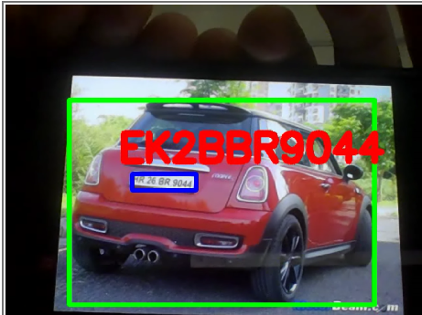
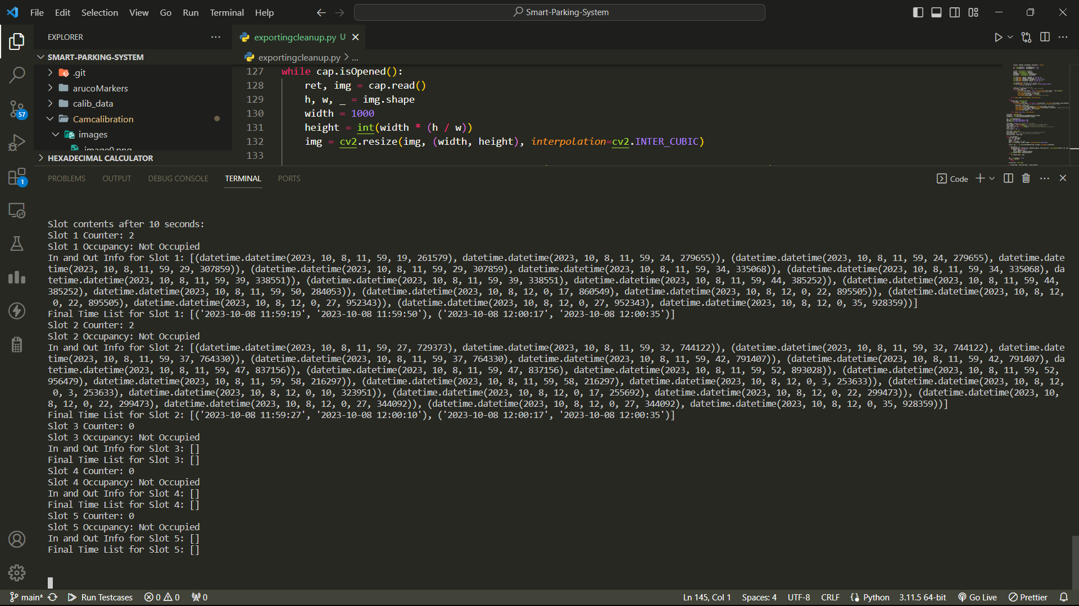
Previous work
Aruco Tags are detected, but the slot is getting reset sometimes due to camera fluctuations, resulting in incorrect in/out time
The metrics of number plate detection is poor currently, need to train the model further to detect the number plate correctly for live scenarios.
Number Plate is not following the number plate template sometimes

Slide 7
Results
Using YOLO to detect the Aruco tags gave many unnecessary bounding boxes.
To rectify this error, I have first run the code for Number Plate Detection. Then we check if this customer is a premium customer or not from some existing database
Then we run the code for parking detection. This captures real time data and exports the required live data into a CSV file.
Added a Regular Expression for Indian Number Plates and implemented some error checks. If any character is recognised as a number, then the closest matching character is rewritten based on a preset dict.

Slide 8
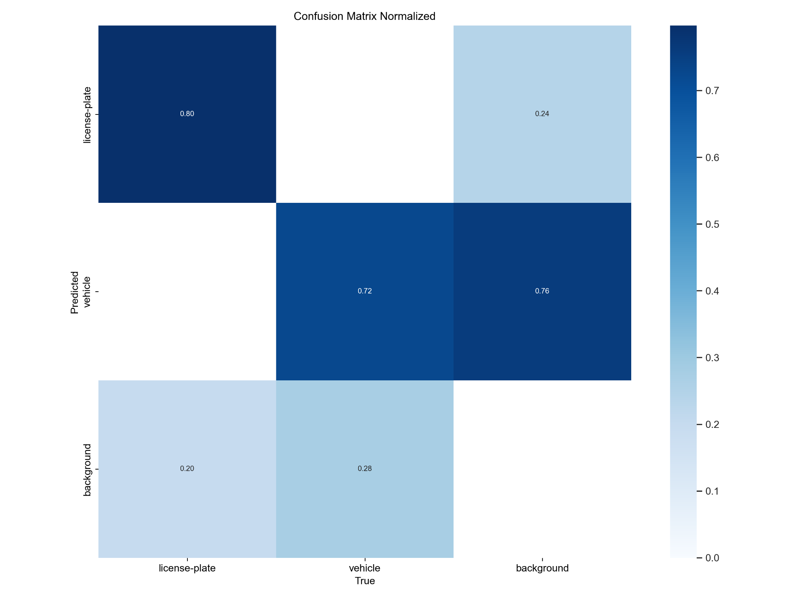
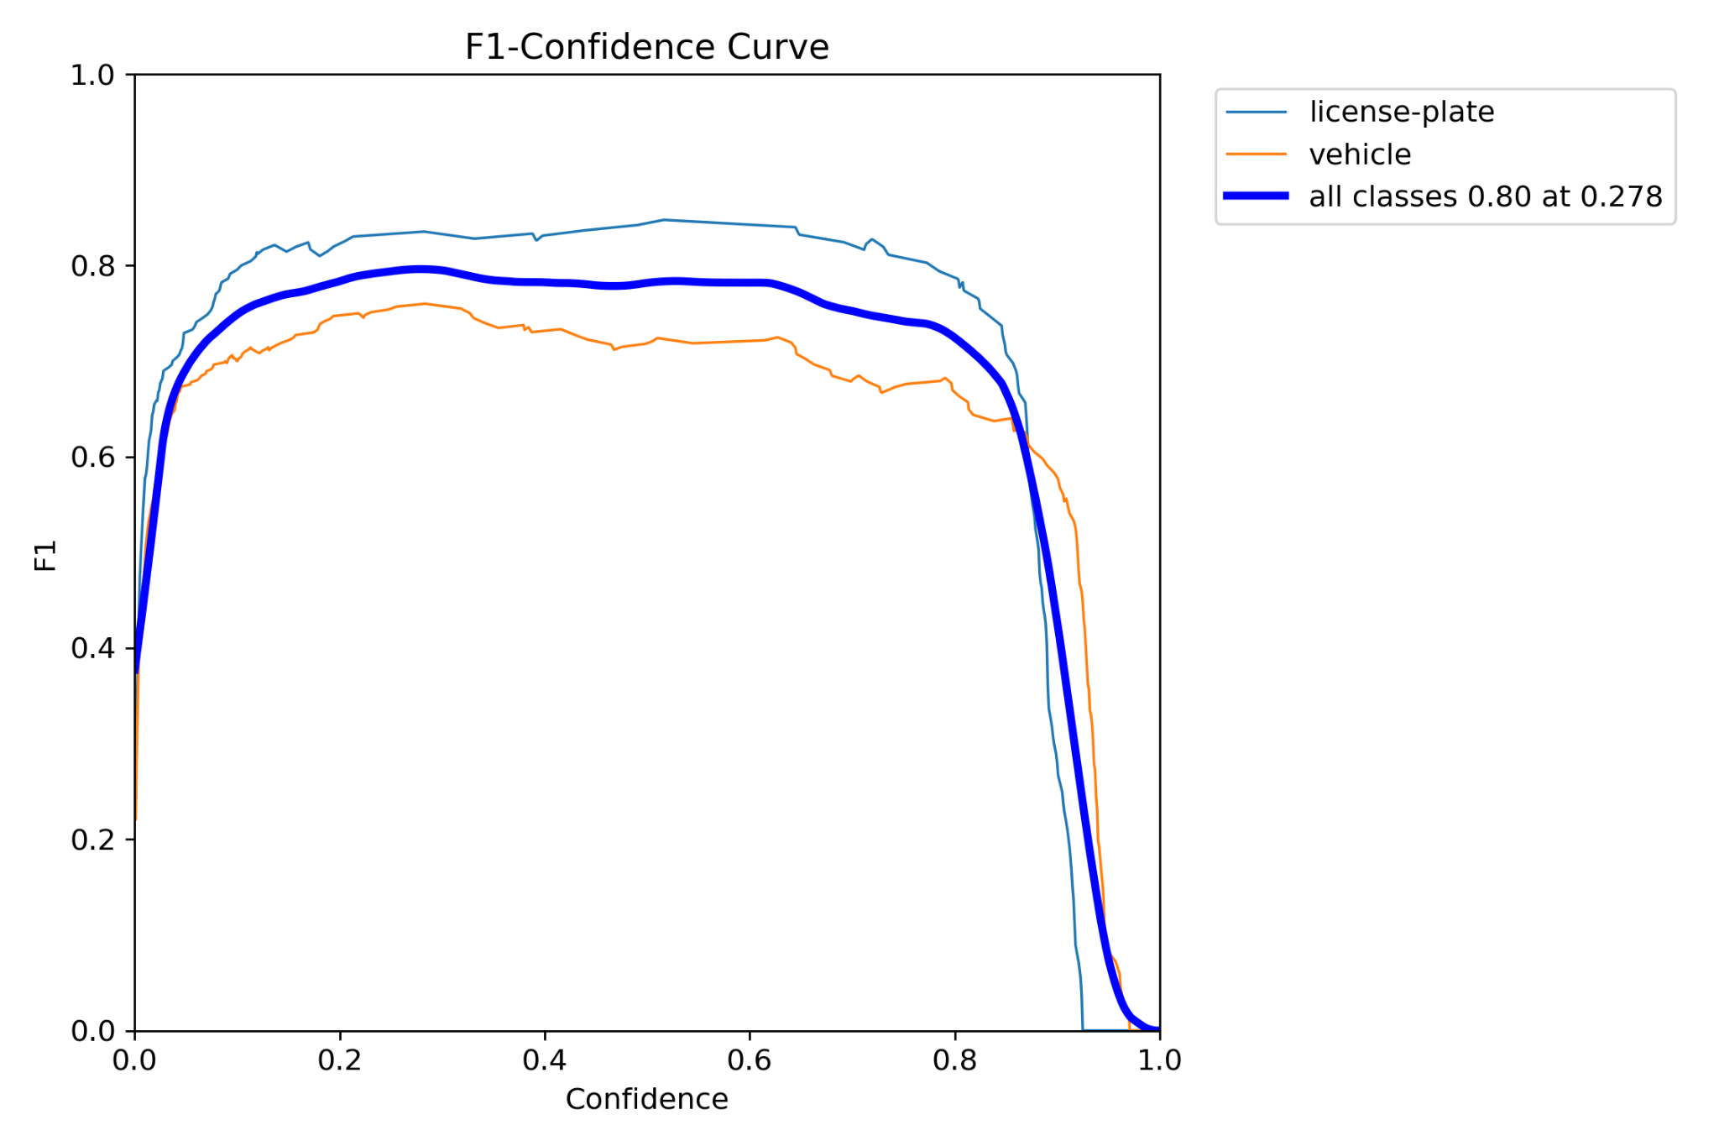
Metrics for bounding box detections

Slide 9
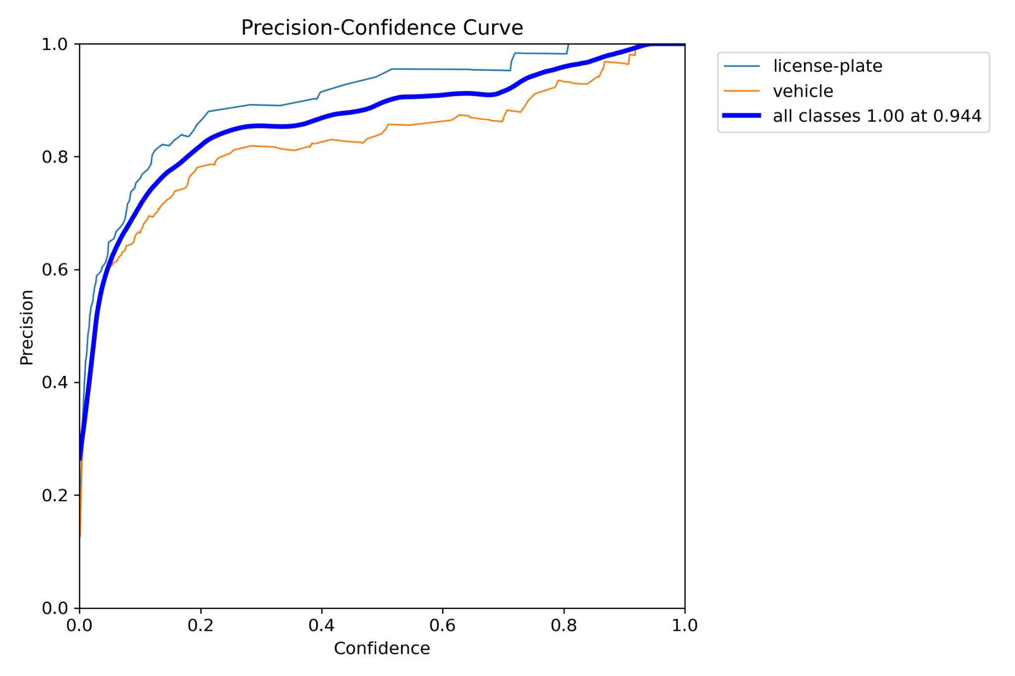
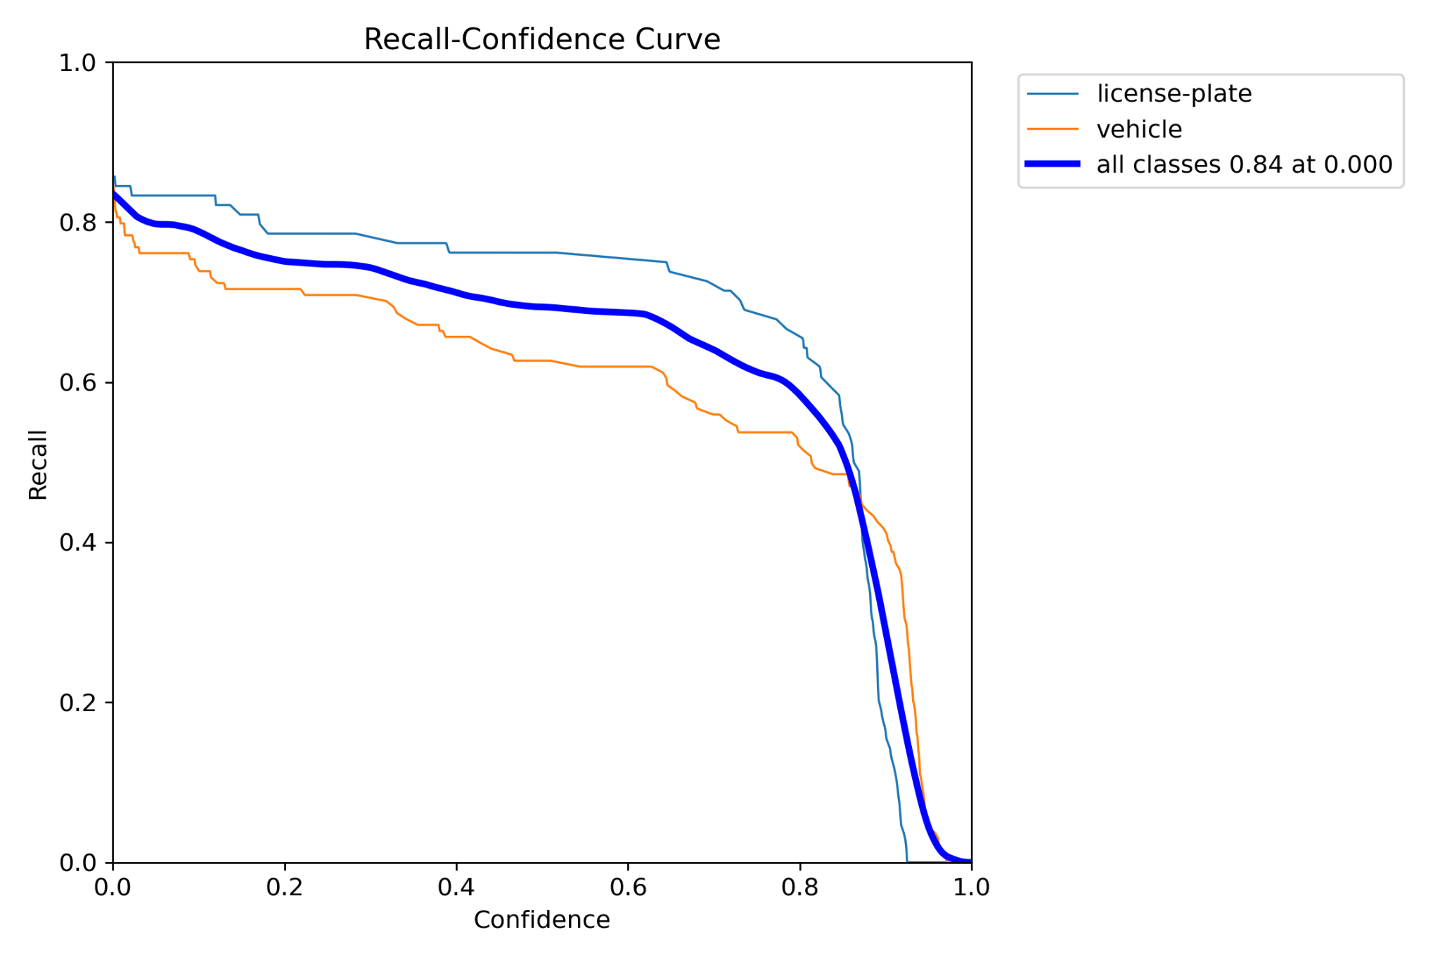
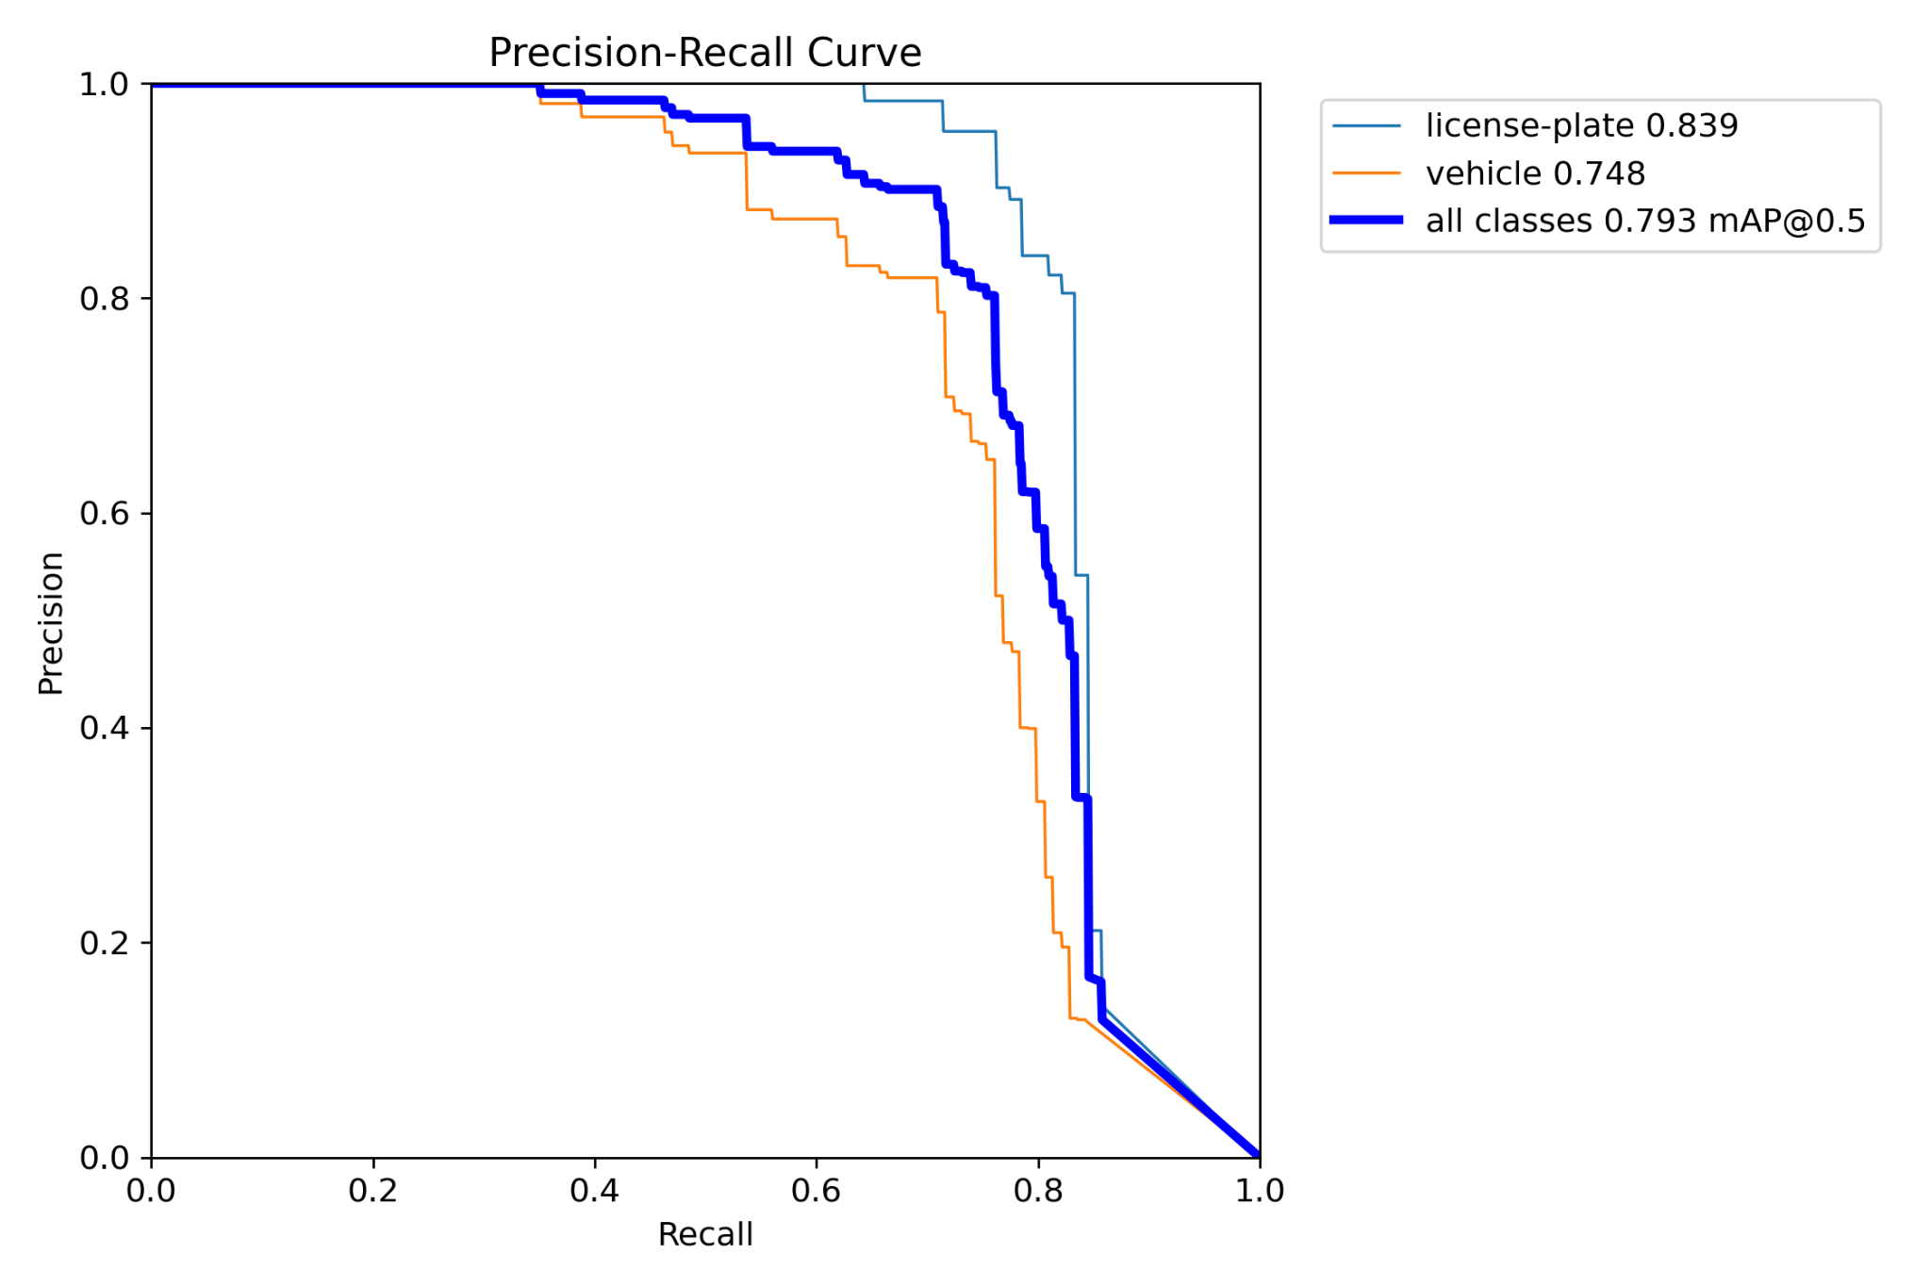
Metrics for bounding box detections

Slide 10
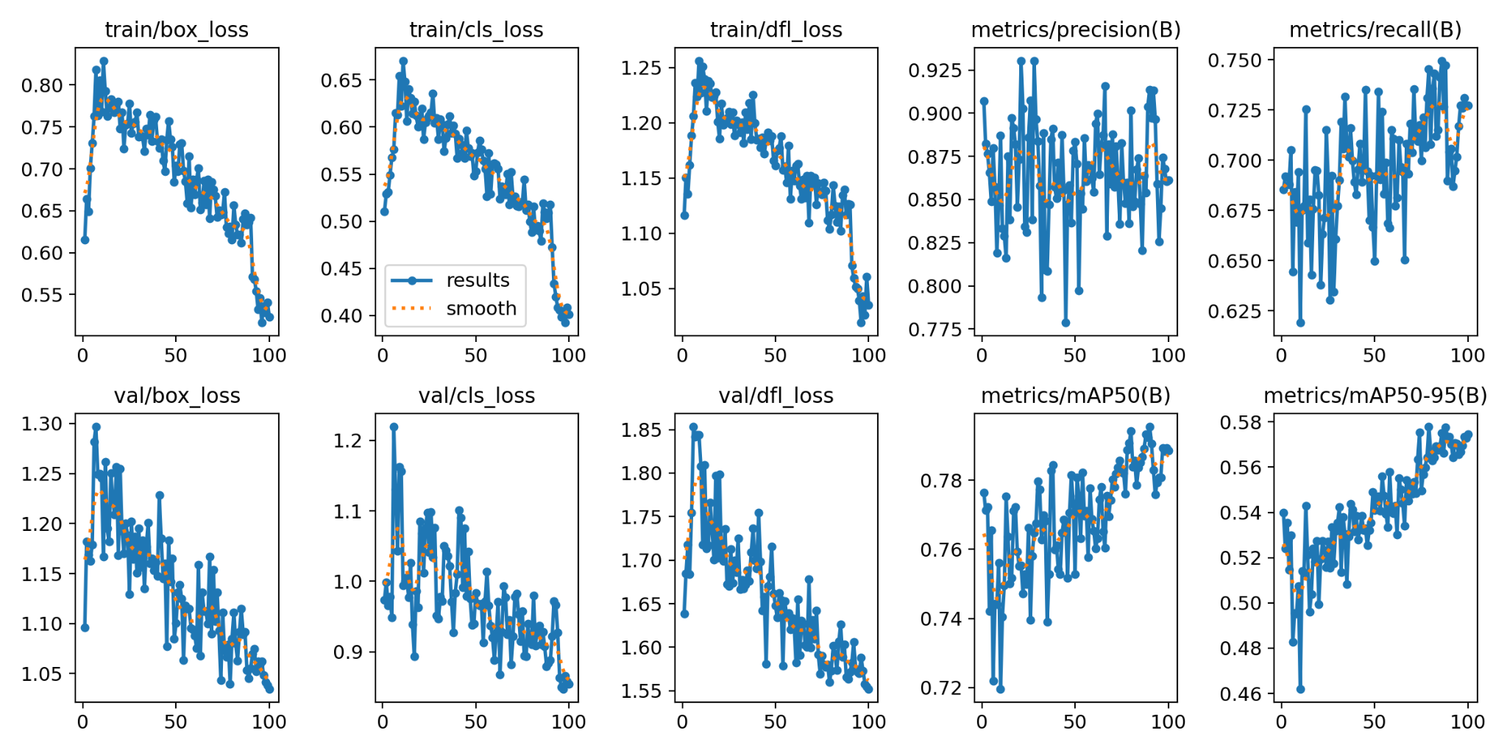
Metrics for bounding box detections

Slide 11
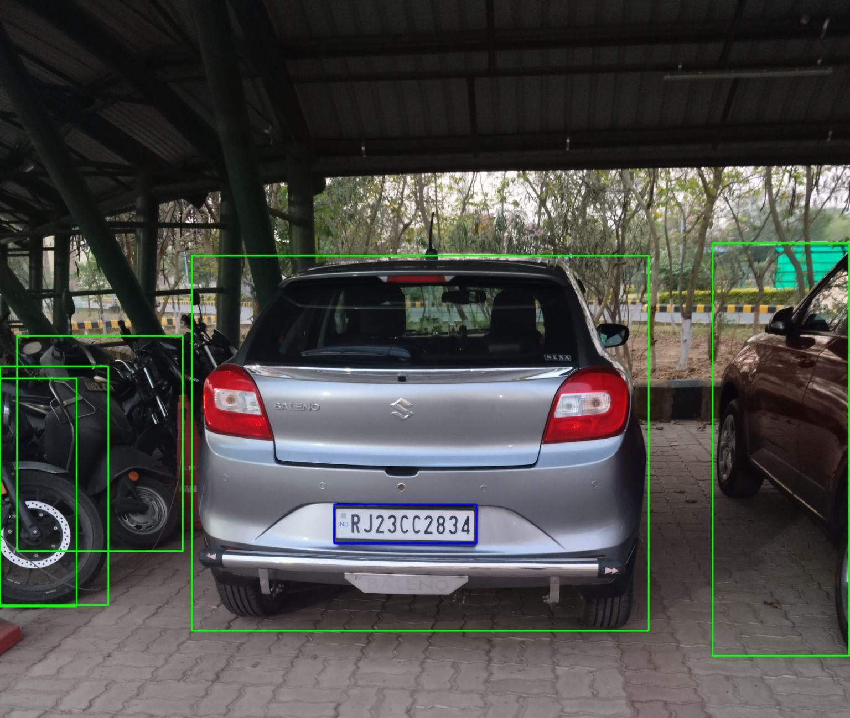
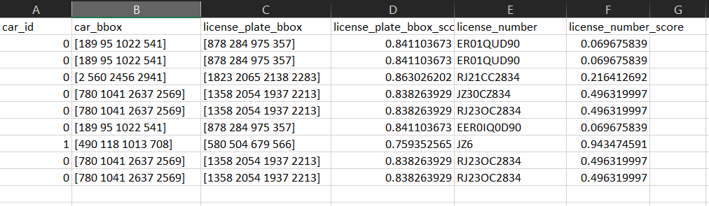
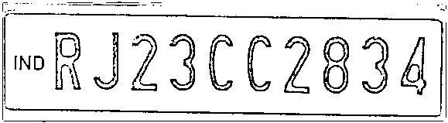
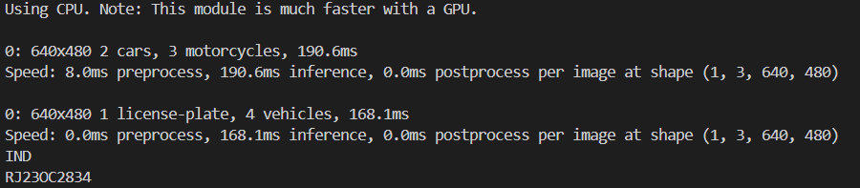
Results for Number Plate Detection

Slide 12
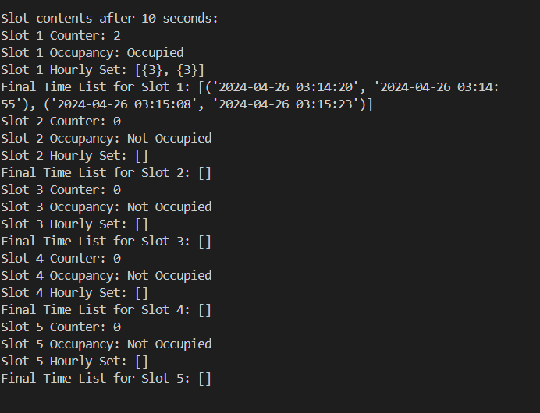
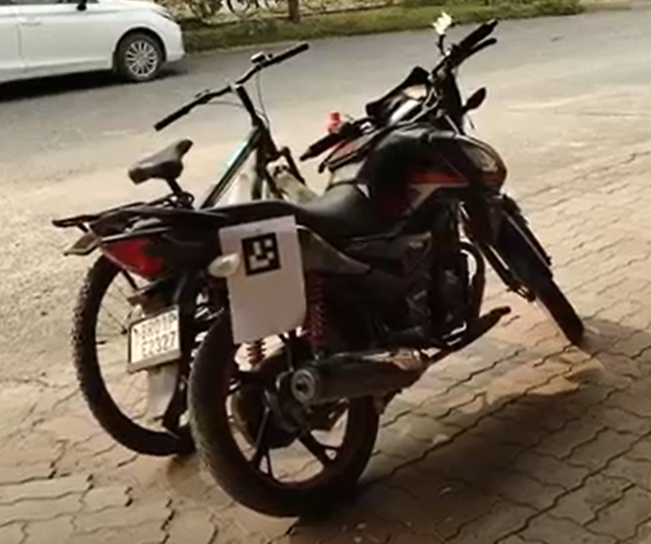
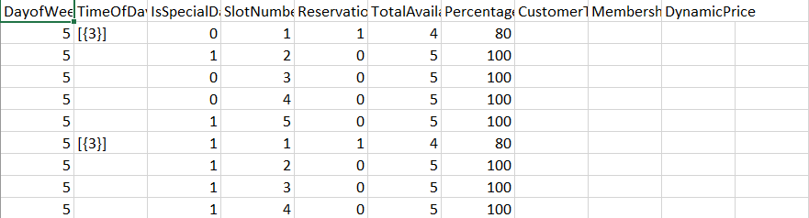
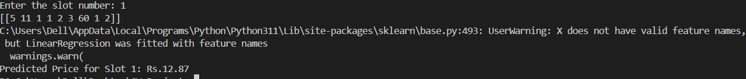
Results for Parking System

